Slide 1


Department of Electrical and Electronics Engineering Final Year (2020-2024) Batch - VIII Semester 18EEP402L – Project Work – Phase II
Final Viva Voce
EXPERIMENTAL ANALYSIS OF RENEWABLE ENERGY SOURCE FED BATTERY STORAGE SYSTEM FOR VEHICLE TO GRID APPLICATION USING AI TECHNIQUES
GUIDED BY:
Dr. S. Sathish Kumar, M.E., Ph.D.,
Associate Professor,
Department of EEE
Project Team Members:
1. Dinesh Kumar V 20BEE4016
2. Jeeva M 20BEE4024
3. Kathiravan KS 20BEE4030
4. Barathiraja B 20BEE4303

Slide 2
OVERVIEW OF PRESENTATION
Objective
Abstract
Introduction
Proposed method
Circuit Diagram
Simulation Diagram
Comparision of Simulation and Experiment
Results and Discussion
Specification
Conclusion
References

Slide 3
OBJECTIVE
The study aims to evaluate the feasibility and effectiveness of integrating renewable energy sources and battery storage systems for vehicle-to-grid (V2G) applications using AI techniques.
It involves assessing renewable energy sources, analyzing battery storage systems, and investigating the potential of V2G technology. AI techniques are applied to optimize system performance, assessing economic and environmental impact.
The performance of battery storage systems in storing and supplying electricity to electric vehicles and the grid.

Slide 4
ABSTRACT
The proposed system is a renewable energy source fed battery storage system for vehicle-to-grid application using Artificial Intelligence(AI) technology. We getting renewable Energy source from solar photovoltaic Panel.
The system utilizes solar photovoltaic energy sources connected to a PIC microcontroller and AI for energy management based on the maximum power demand in Grid.
This innovative system aims to integrate renewable energy sources with battery storage and AI technology, facilitating vehicle-to-grid operations.

Slide 5
ABSTRACT(cont..)
The use of AI technology promises to optimize battery life cycle data monitoring. To address rural areas disconnected from the grid, this PV system integrated with an ultra-capacitor represents among the most exciting sources of renewable energy sources available today.
This proposed system can assist are not available. Furthermore, it may provide added benefits to consumers by lowering electric vehicle costs and increasing demand for Electric Vehicles through utilizing renewable sources to charge batteries based on maximum peak demand in the grid.
The system enables a prosumer to sell excess energy to the utility or participate in the market with higher prices, reducing operational costs and grid dependency.

Slide 6
INTRODUCTION
A Renewable Energy Source fed Battery Storage System for Vehicle to Grid Application Using AI Technology is a system that combines renewable energy sources, battery storage, and artificial intelligence technology.
The solar energy from photovoltaic systems as a renewable energy source to charge the Electric vehicle battery to supply the power to the grid.
Renewable Energy Source comprises of sustainable energy sources such solar that are incorporated with systems for storage and intelligent control techniques will provide reliable and efficient power supply.

Slide 7
INTRODUCTION(cont..)
This system aims to address the challenges of conventional electrical grids, including the inability to fulfil peak demand, expensive power outages, and pollution-induced environmental catastrophes.
The integration of renewable energy sources and electric vehicles into the grid is based on research into cutting-edge smart metering and communication systems.
The use of artificial intelligence promises battery life cycle data monitoring and enables the efficient management of hybrid renewable energy sources

Slide 8
PROPOSED BLOCK DIAGRAM OF EXPERIMENTAL ANALYSIS OF RENEWABLE ENERGY SOURCE FED BATTERY STORAGE SYSTEM FOR VEHICLE TO GRID APPLICATION USING AI TECHNIQUES
12V
DC/AC
230V AC
13.5V
Electric Vehicle
Battery
12V
Inverter
To Grid
230V AC
14.5V
DC/DC
MPPT
PIC 16f887a
4700uf 50V
Ultra capacitor
LCD Display
AI
PV
Power supply
5V
12V 10W

Slide 9
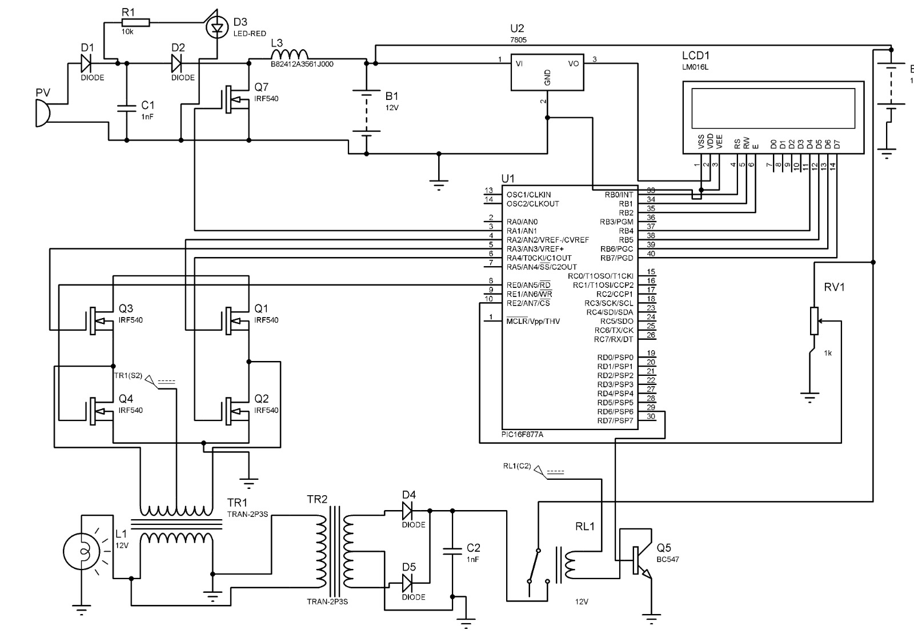
PROPOSED CIRUIT DIAGRAM OF EXPERIMENTAL ANALYSIS OF RENEWABLE ENERGY SOURCE FED BATTERY STORAGE SYSTEM FOR VEHICLE TO GRID APPLICATION USING AI TECHNIQUES
AI
AI

Slide 10
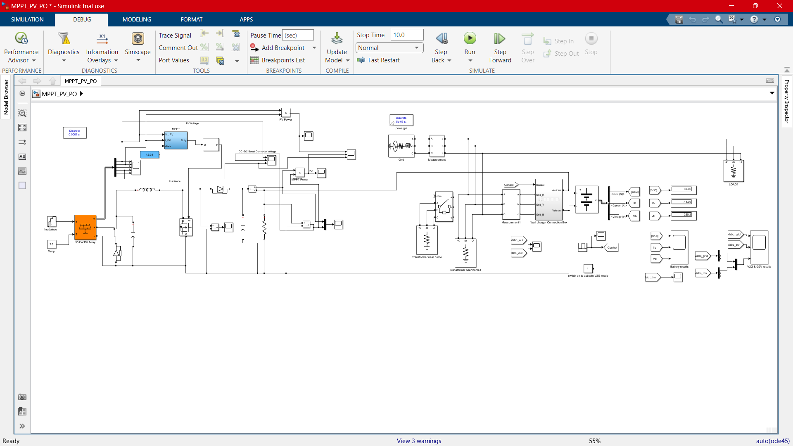
PROPOSED SIMULATION DIAGRAM OF EXPERIMENTAL ANALYSIS OF RENEWABLE ENERGY SOURCE FED BATTERY STORAGE SYSTEM FOR VEHICLE TO GRID APPLICATION USING AI TECHNIQUES

Slide 11
COMPARISION OF SIMULATION AND EXPERIMENT
PARAMETER | SIMULATION | EXPERIMENT
PV Panel | 2000W/100V | 10W/12V
Converter | 100V/10A | 14.5V/10A
Battery | 250V/13A | 12V/5A
Inverter | 2000W/250V | 300W/12V
Control | ANN | PIC Control

Slide 12
COMPARISION OF SIMULATION AND EXPERIMENT
PARAMETER | SIMULATION | EXPERIMENT
Renewable Energy Source | Control algorithms for maximum power point tracking (MPPT) and grid interaction. | Solar panels
Battery Storage System | Battery management system (BMS) for state-of-charge (SoC) estimation, balancing, and protection. | Lithium-ion battery
Safety and Reliability | Fault detection and isolation (FDI) algorithms, cybersecurity measures. | Redundant power electronics, safety mechanisms (fuses, breakers)
AI Techniques | In Software we implement the AI in wall charger connection box of the control systems for real-time monitoring and control, reinforcement learning for adaptive control strategies. | Machine Learning ANN models for prediction and optimization
Data Processing | Edge computing platforms, cloud-based analytics. | Microcontroller(PIC)
18EEP401L-PROJECT WORK PHASE 2

Slide 13
RESULTS AND DISCUSSION
It Examines the use of Artificial intelligence (AI) in a Renewable energy source fed Battery storage system for Vehicle-to-Grid (V2G) applications. The experiment involved data collection, Energy Generation, and Battery charging and discharging efficiency. The results showed that AI techniques significantly improved the system’s Performance, Adaptability, and Responsiveness to varying conditions. However, challenges such as data limitations and model uncertainties were acknowledged. The study concludes by emphasizing the importance of Integrating Renewable Energy sources, Battery storage, and AI techniques for V2G applications.

Slide 14
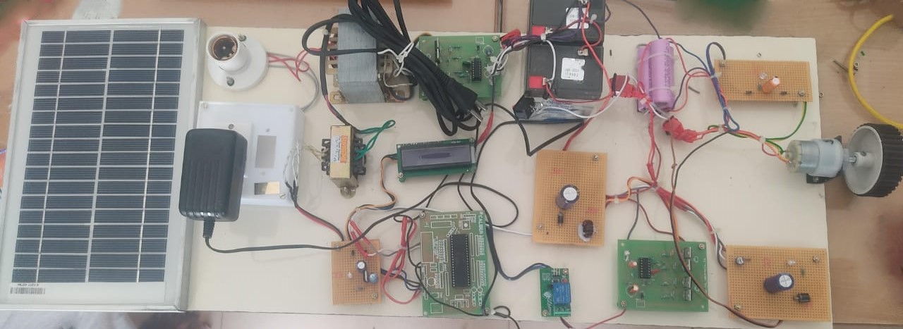
PROPOSED HARDWARE KIT
Solar panel
Load
Inverter
Lead acid Battery
Motor drive
Transformer
Lithium-ion Battery
DC Motor
DC-DC
Converter
LCD
Ultra Capacitor
G2V
Drive
MPPT
Relay
PIC

Slide 15
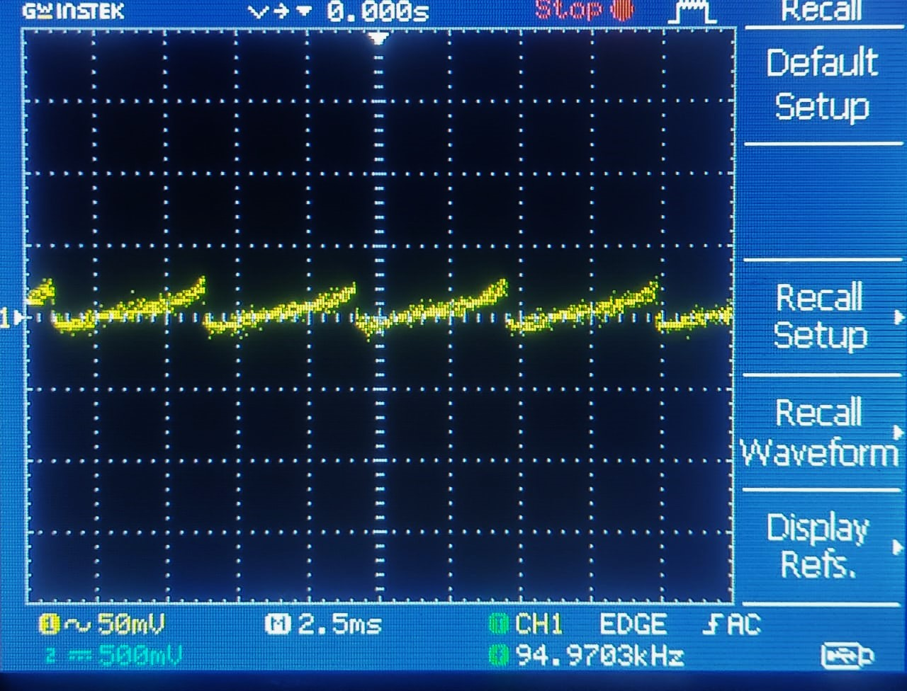
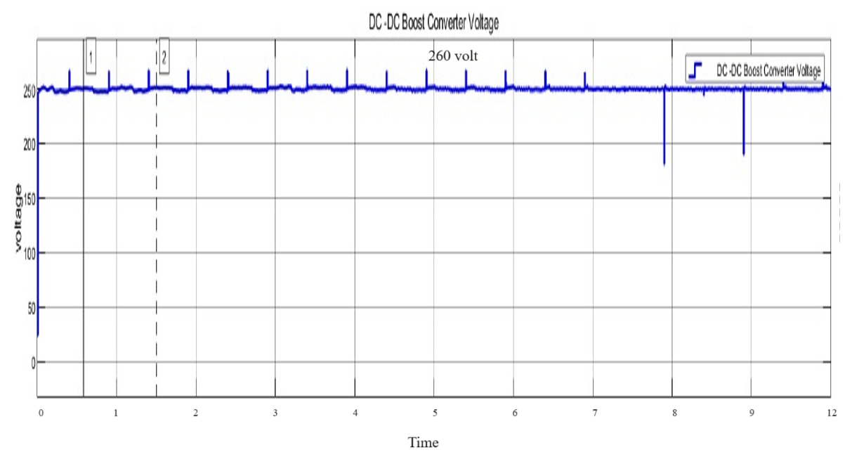
COMPARISION OF OUTPUT WAVE FORM OF DC-DC CONVERTER DURING BATTERY CHARGING

Slide 16
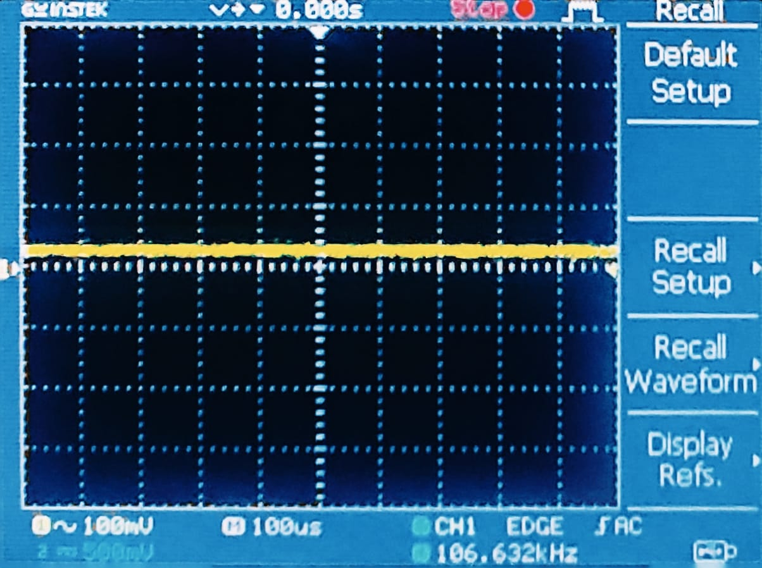
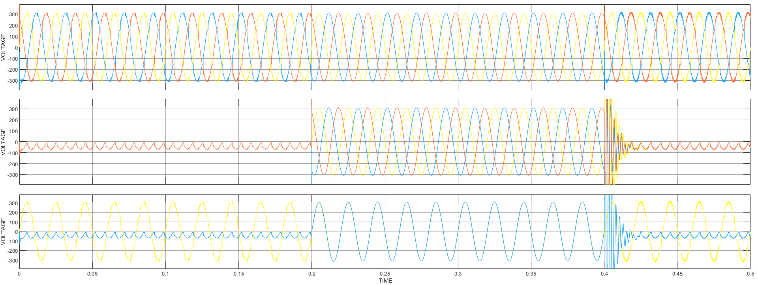
COMPARISION OF OUTPUT WAVE FORM OF ULTRA CAPACITOR SUPPLY TO THE CONVERTER

Slide 17
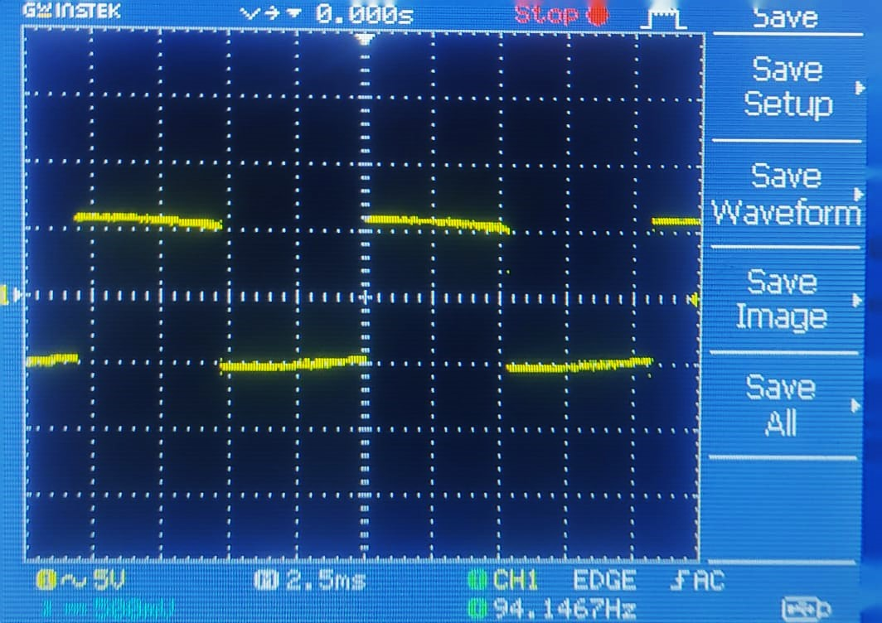
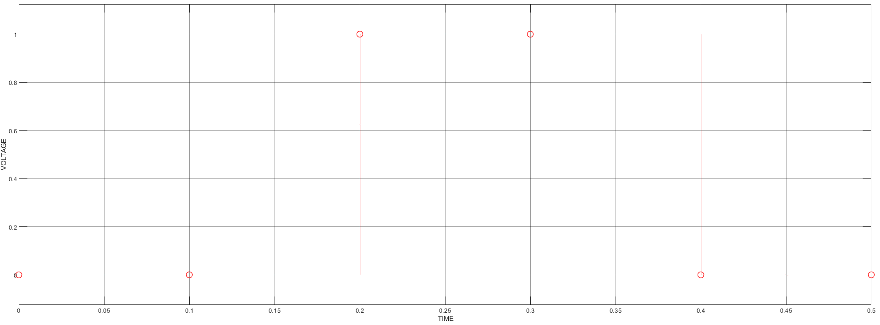
COMPARISION OF OUTPUT WAVE FORM OF INVERTER DURING BATTERY DISCHARGING

Slide 18
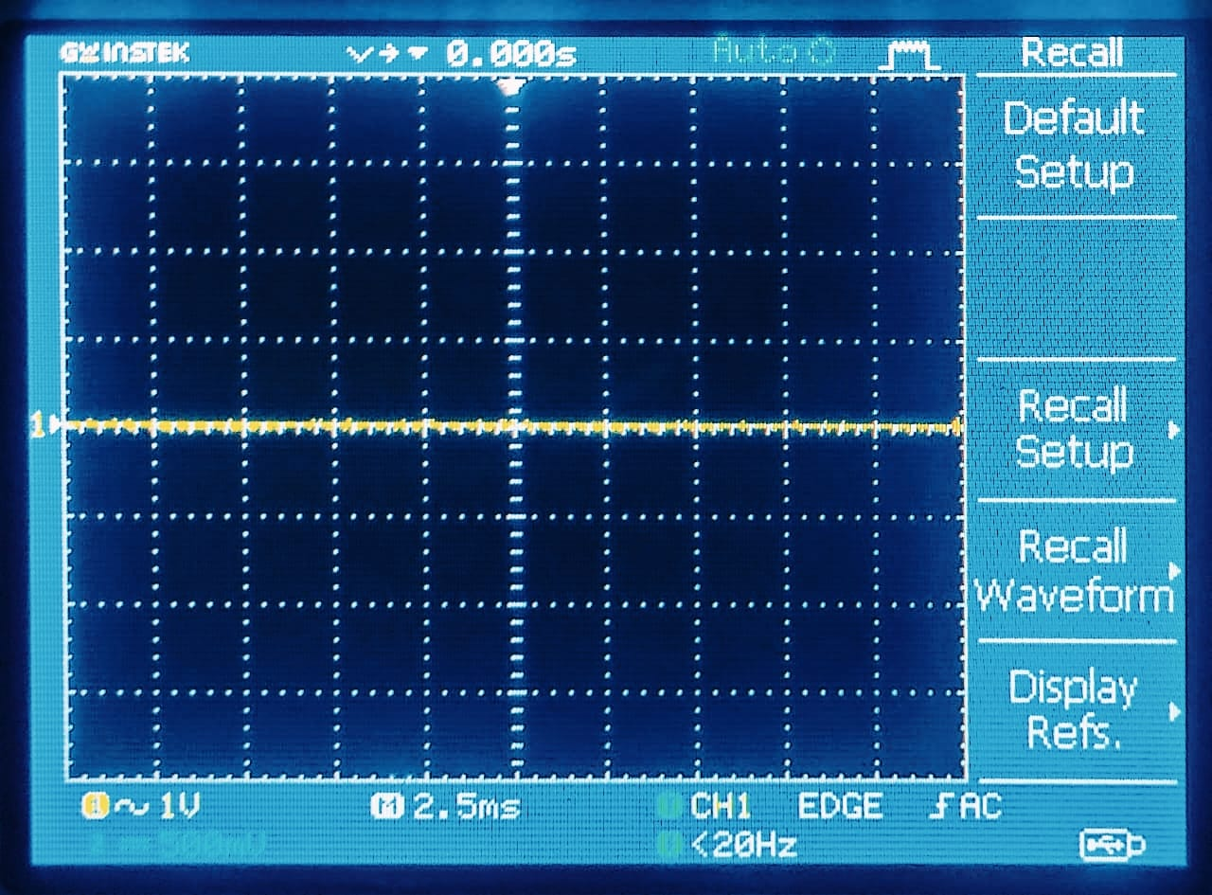
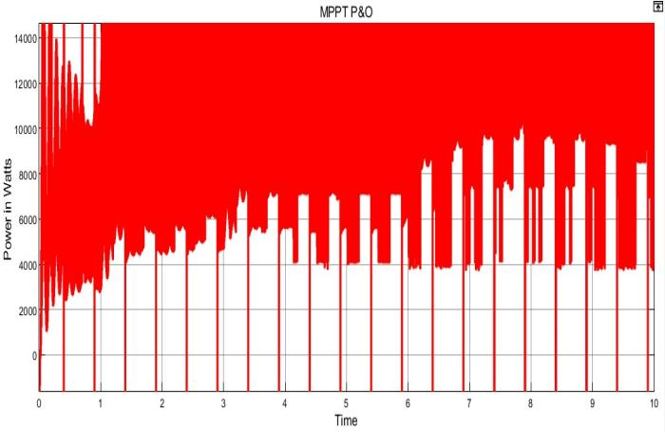
COMPARISION OF OUTPUT WAVE FORM OF MAXIMUM POWER POINT TRACKING DURING SUPPLY TO THE BATTERY

Slide 19
CONCLUSION
The Improve grid stability by intelligently managing the charging and discharging cycles of EVs based on renewable energy availability and grid demand, the system can help smooth out fluctuations and contribute to a more stable grid.
Increase renewable energy integration by Artifical Intelligence AI can predict renewable energy generation and optimize battery storage to effectively utilize renewable energy sources, reducing reliance on fossil fuels.
Enhance V2G feasibility the AI-powered system can optimize charging and discharging to minimize the EV batteries, making V2G a more attractive option for protecting the Environment from pollution.

Slide 20


Slide 21





Slide 22
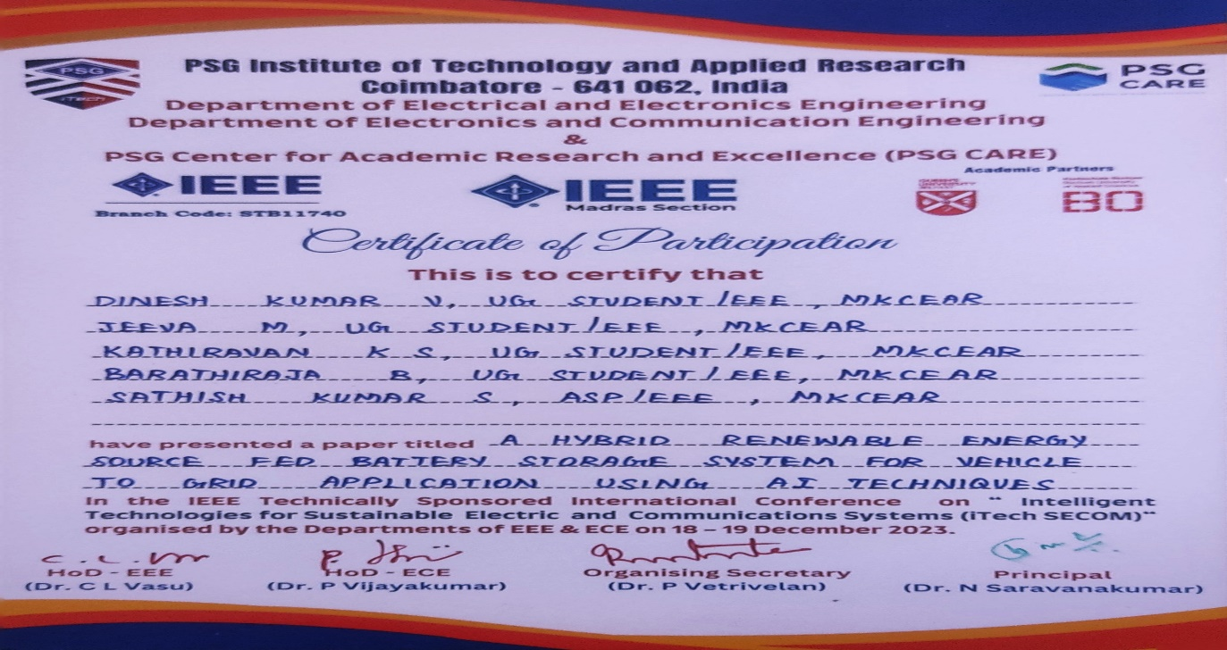

Slide 23
REFERENCES
[1] H. N. de Melo, J. P. F. Trovao, P. G. Pereirinha, H. M. Jorge and C. H. Antunes, “Energy Cost Optimization of Hybrid Renewables Based V2G Microgrid Considering Multi Objective Function by Using Artificial Bee Colony Optimization”-Engineering Science and Technology, an International Journal IEEE Trans. Veh. Technol., vol. 67, no. 1, pp. 114-123, Jan. 2020.
[2] J. R. Aguero, E. Takayesu, D. Novosel and R. Masiello, “Modernizing the Grid: Challenges and Opportunities for a Sustainable Future,” IEEE Power and Energy Magazine, vol. 15, no. 3, pp. 74-83, May-June 2021.
[3] D. Bowermaster, M. Alexander and M. Duvall, “The Need for Charging: Evaluating utility infrastructures for electric vehicles while providing customer support,” IEEE Electrification Magazine, vol. 5, no. 1, pp. 59- 67, March 2020.

Slide 24


